Slide 1
Econ 106
Lecture 19

Slide 2
Reminders
Lab 6 is due Friday 11:59pm
Week 9 Lecture quiz is due Friday 11:59pm
Final projects are due Saturday, 11:59pm

Slide 3
Final Project
Today: work on research project outline
Thursday: zoom office hours instead of class (7-8 pm)
Other office hours this week:
Thursday 2-3pm (Sproul 3121)
Friday 2-3pm (zoom)

Slide 4
Grading: Written Report
Things I will be evaluating:
Does your writeup follow the structure of the outline?
Do you have a strong hypothesis/objective?
Are your visualizations clearly connected to the objective?
Can you interpret your visualizations correctly?
Can you provide a reason for the observed trends in your visualizations?
Can you connect the findings to your objective?
Does your research project reflect independent thought and originality?

Slide 5
Grading: R script
Things I will be evaluating:
Does your code clean your data and generate your visualizations?
Is the code organized/commented/easy to follow?
Do you cite external sources (ChatGPT) when it was used to generate parts of your code?
Does your code demonstrate the use of skills we covered during lecture, or did you completely rely on ChatGPT for your analysis?

Slide 6
Student Example 1: Police Stops in Oakland

Slide 7
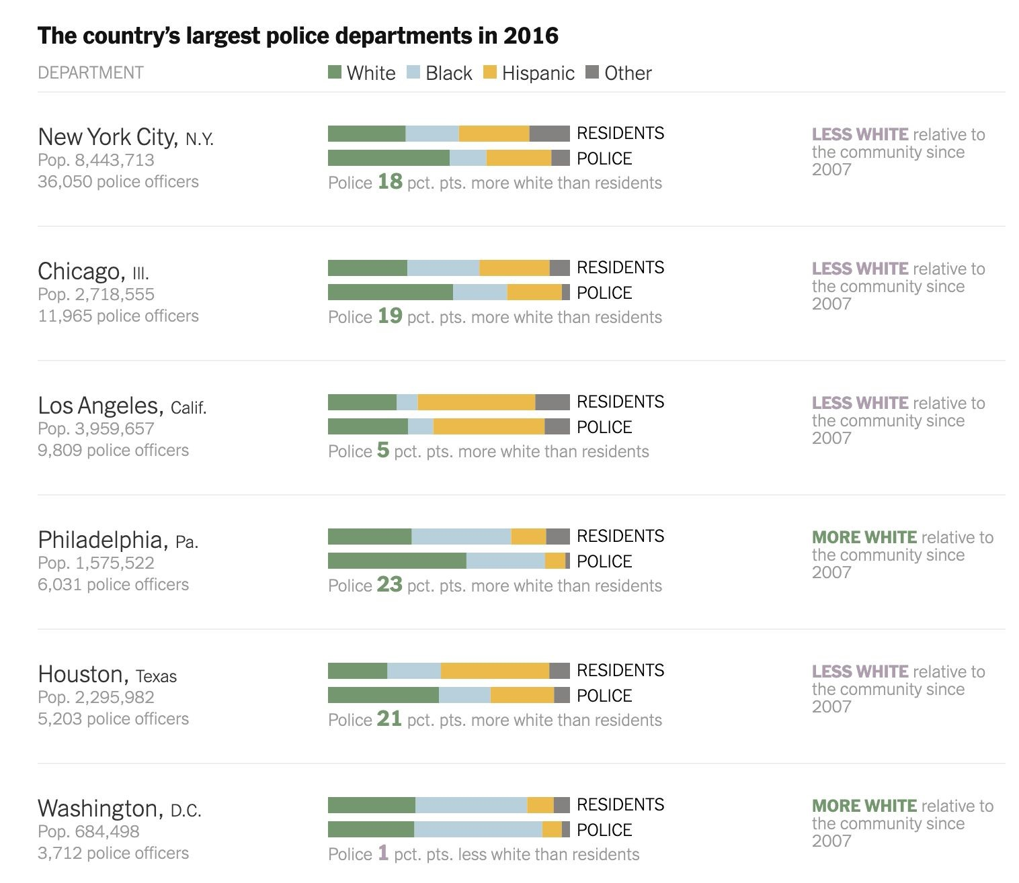
Introduction &
Background
During the 2020 elections, Democratic candidate
Bernie Sanders’s solution to police brutality was
diversifying local police departments so that police
officers represented the people they were serving. I
want to take a step back and see if the problem truly
stems from police departments that lack diversity and
if that is a cause of racial biases in policing.
My motivation behind this project is to see if analytical
research can help come up with effective solutions to
large problems. Can public policies backed by
empirical evidence be successful when put in place
and can they win the support of the public? And I
hope to gain some analytical skills that can help me
find solutions to many other community-specific
social issues because that is the type of work I would
like to do once I enter the industry.
Source: The New York Times

Slide 8
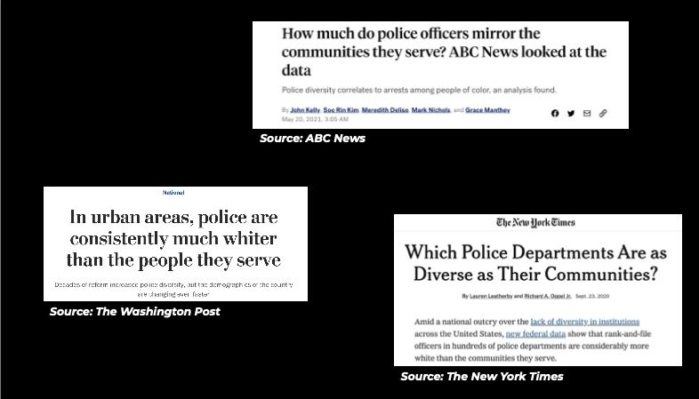

Slide 9
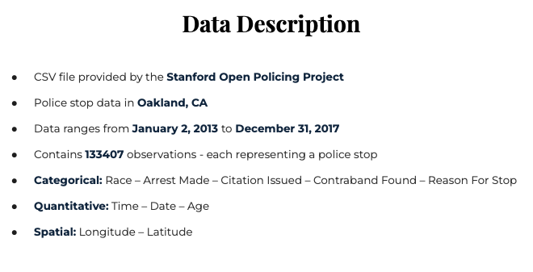

Slide 10
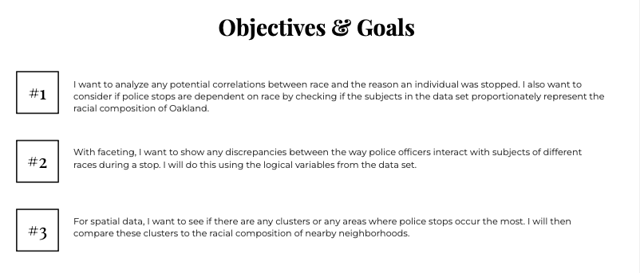

Slide 11
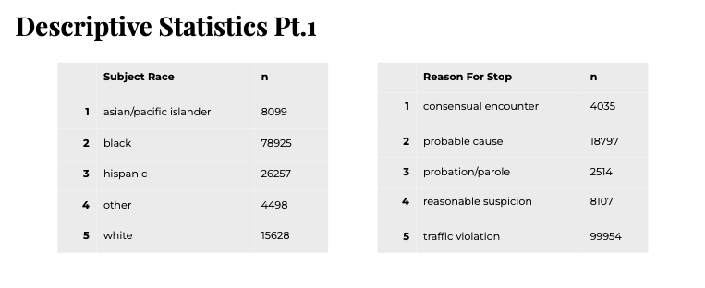
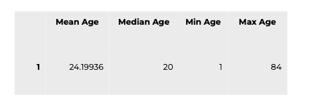
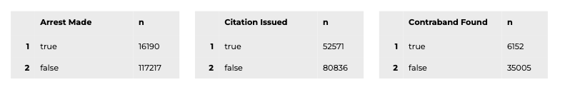
Good, but could have used bar charts to display frequencies (with counts labeled)

Slide 12
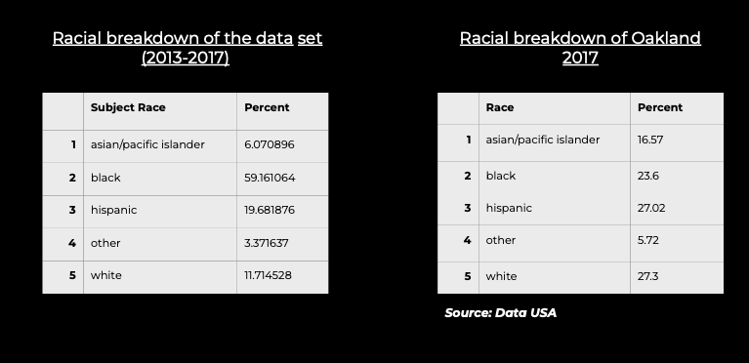
What makes this project stand out: student looks up additional information on the racial composition of Oakland and compares it to the racial composition of arrests

Slide 13
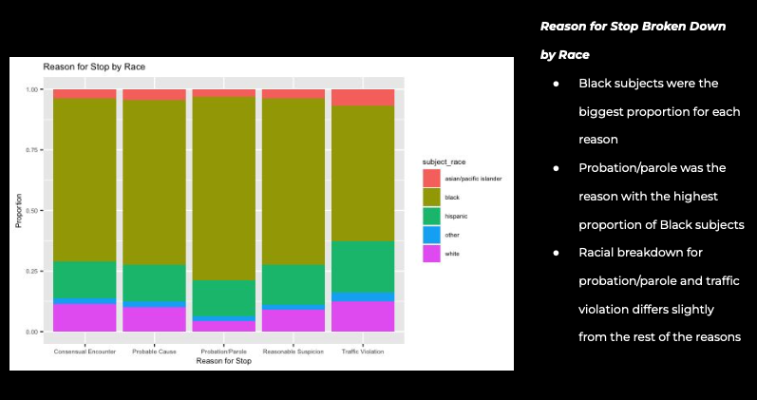

Slide 14
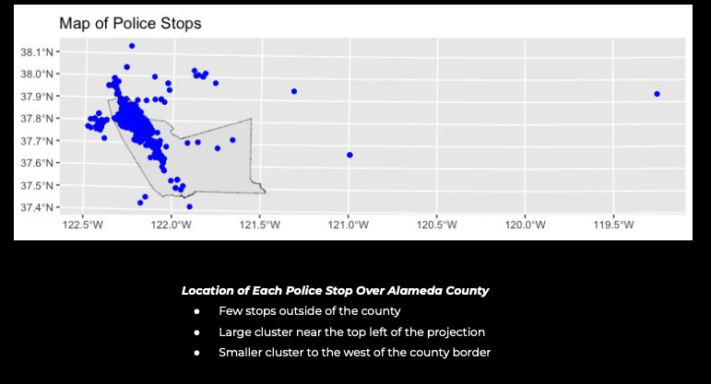

Slide 15
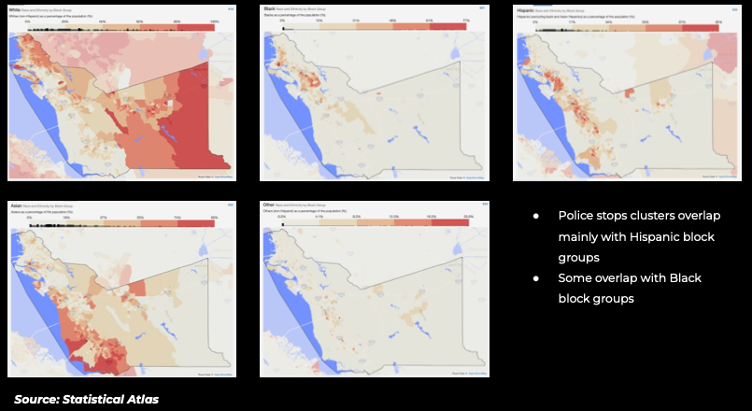
Another example of collecting additional information to provide context for the results.

Slide 16
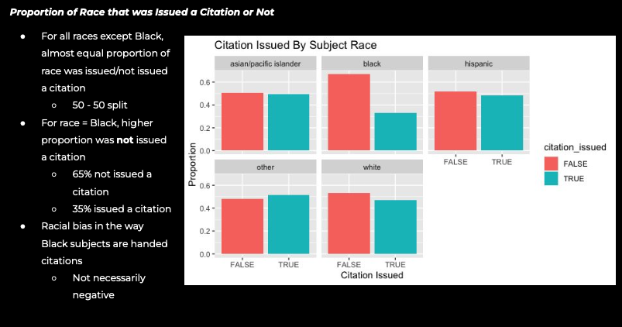

Slide 17
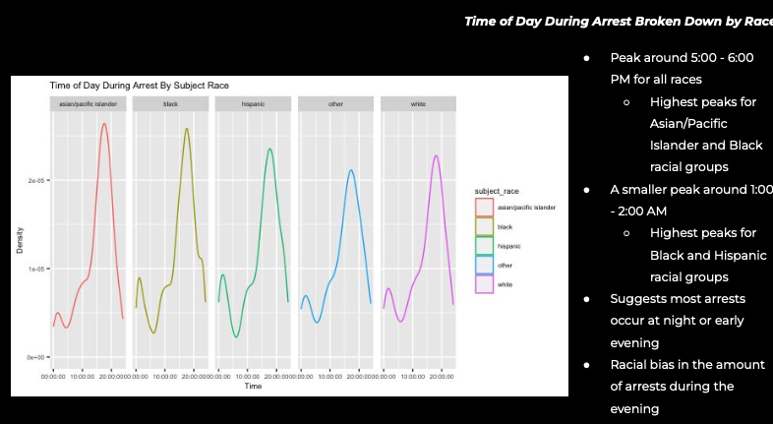
This graph would look better with the densities faceted vertically, or use ggridges

Slide 18
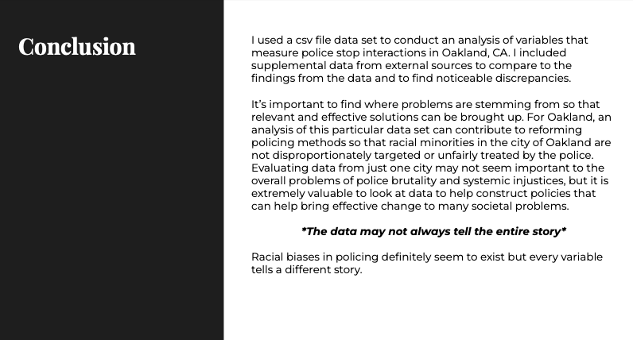

Slide 19
Example 2: Attitudes on Abortion

Slide 20
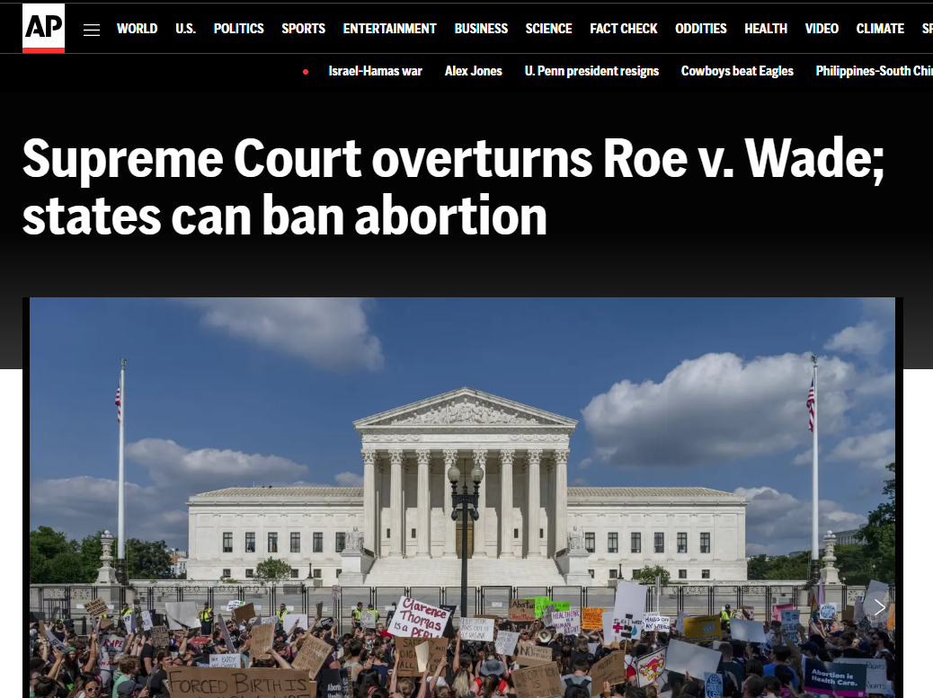
Motivation
Stark difference in opinion
Increased debate since the overturning of Roe v Wade
Strong motivation, relevant news article for the topic
https://apnews.com/article/abortion-supreme-court-decision-854f60302f21c2c35129e58cf8d8a7b0

Slide 21
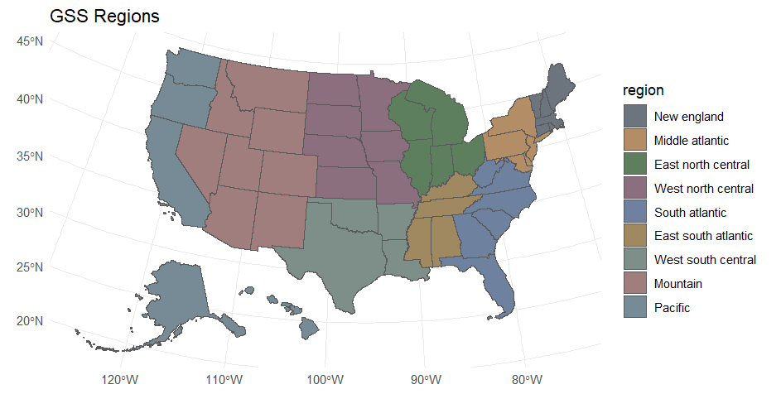
GSS
General Social Survey
National Opinion Research Center
University of Chicago
1972-2022
Missing: unit of observation, number of observations

Slide 22
Data Dictionary
Variable name | Description | Type | Classification
year | Year of response | numeric | categorical
id | Identifying number | numeric | categorical
childs | Number of children | numeric | numerical
sibs | Number of siblings | numeric | numerical
region | 9 region partition of USA | factor | categorical
sex | Male or Female | factor | categorical
relig | Religious affiliation | factor | categorical
abany | Abortion for any reason | factor | categorical
partyid | Political party | factor | categorical
Note: this should have summary statistics, not just descriptions of the variables

Slide 23
Goals
Objective could have been more explicit:
The student examines attitudes on abortion and it’s relation to:
region
time
age
gender
religion
Providing a prediction for anticipated findings would also be helpful here.
What are the differences between pro vs anti abortion people?
What are the most predictive factors?

Slide 24
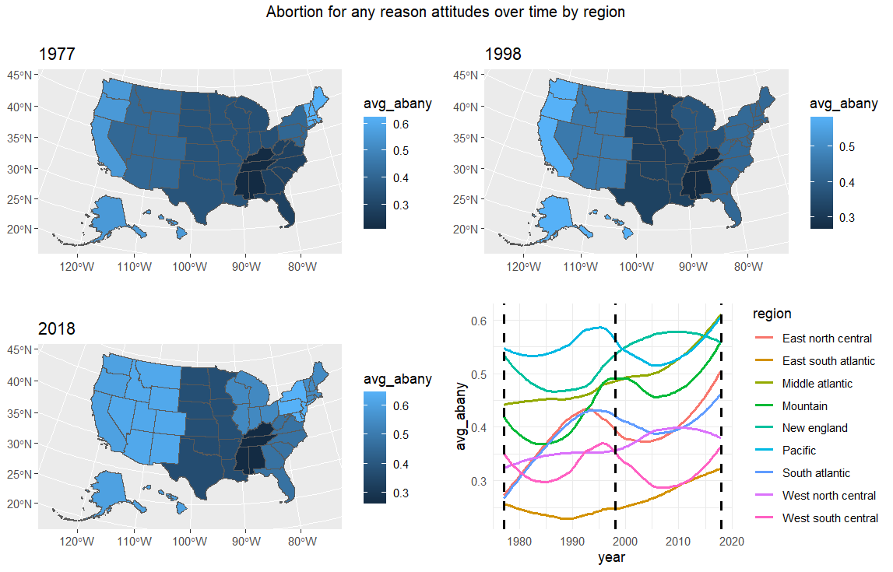
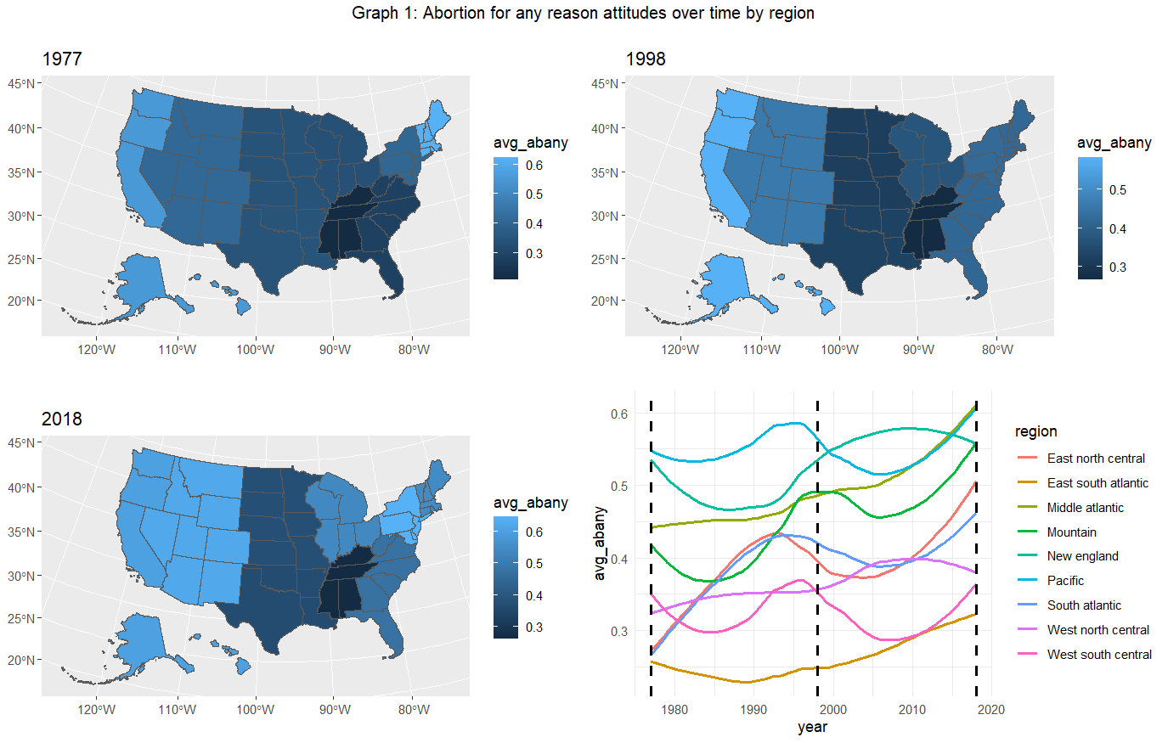
Better color gradient would help. Line graph should have fewer levels, choose a custom color palette.

Slide 25
Discussion
Charts show that support for abortion has been increasing over time
the west and east coast has historically been more in favor of abortion, but Midwest regions have since shown more support
Possible reasons why?
region linked to party affiliation
societial norms have been shifting over time

Slide 26
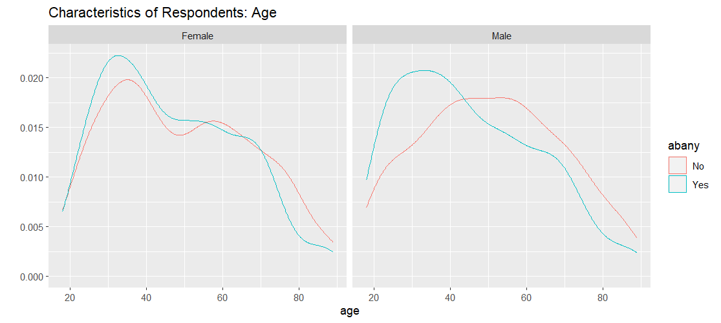
Background color would look better as white (theme_bw)
Title should reflect findings in the charts
Would look better using the fill argument
I would have also tried a boxplot

Slide 27
Discussion
Charts show that support for abortion differs by gender and age
Men who support abortion are typically younger (around 25), opponents are older (around 50)
For women, the age distribution is fairly similar between proponents and opponents of abortion (age plays less of a role in opinions)

Slide 28
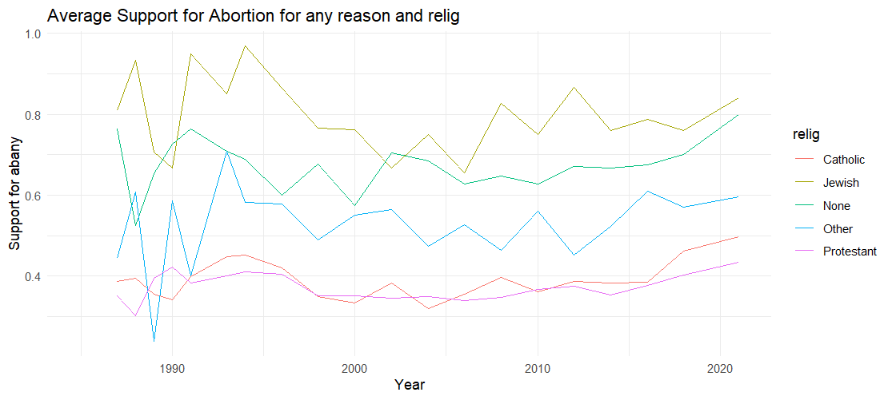
Title should provide a preview of the findings

Slide 29
Discussion
Chart shows trends in support for abortion by religious affiliation
highest level of support amongst Jewish, atheists
Protestants and Catholics remain most opposed to abortion
Provide some explanation as to why….

Slide 30
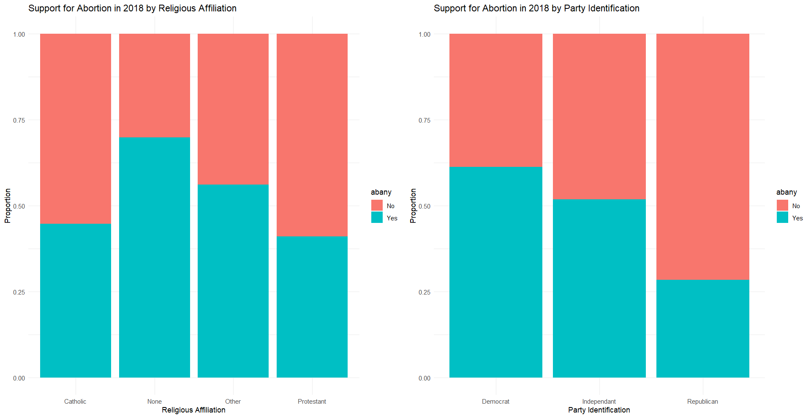

Slide 31
Discussion
Charts compare the role of religion vs party affiliation in support for abortion
Lowest support for abortion amongst protestants, catholics, and republicans
It’s likely that there is a great deal of overlap between religion and party affiliation

Slide 32
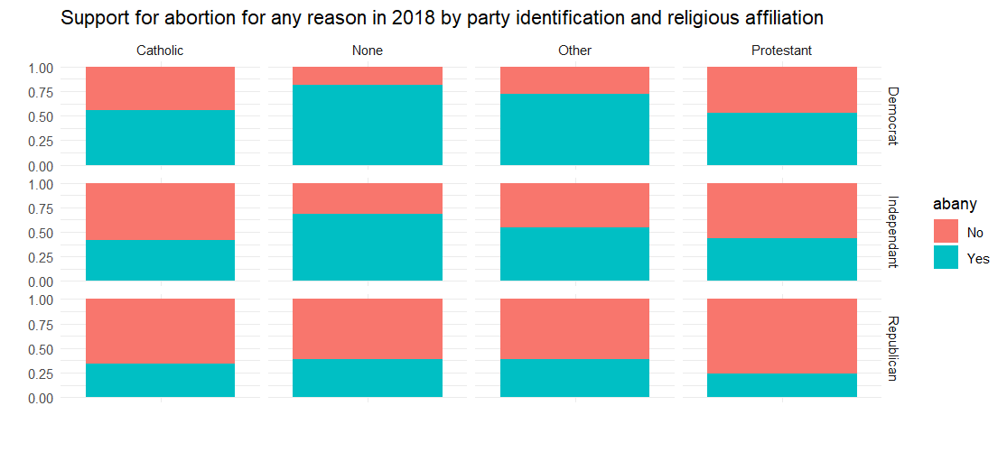

Slide 33
Discussion
Charts compare the role of religion combined with party affiliation in support for abortion
Lowest support for abortion amongst protestant republicans
highest support for abortion amongst atheist democrats

Slide 34
Miscellaneous Student Examples

Slide 35
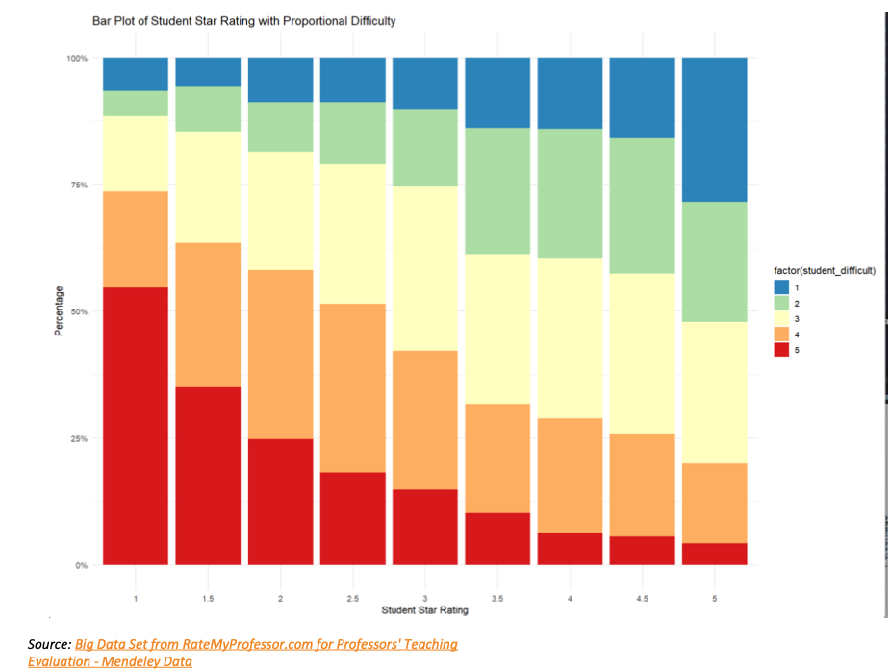
Bar Plot with Color Mapping
Title should describe the findings in the chart, otherwise great use of color and labeling (I like the caption with the data source)

Slide 36
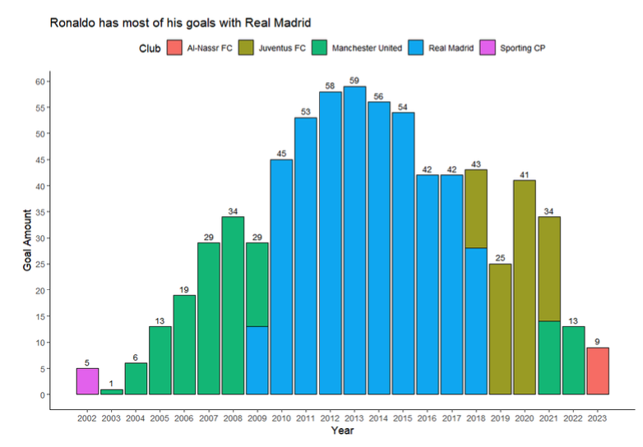
Histogram with color mapping

Slide 37
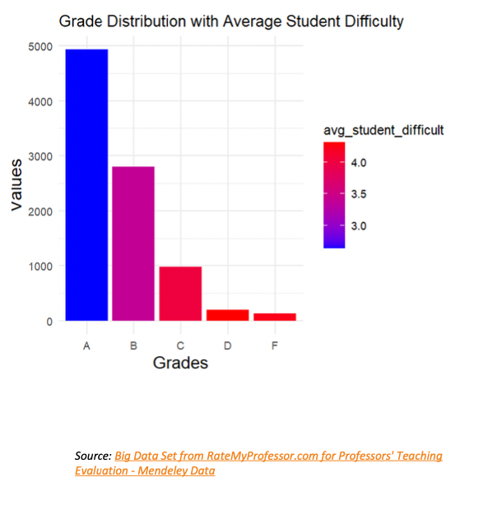
Bar Plot with Color Mapping
Interesting use of color (color is a gradient based on the difficulty rating)

Slide 38
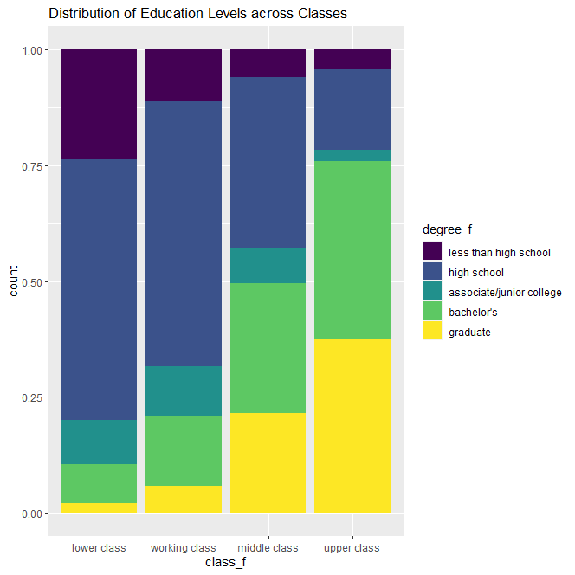
More education often leads to higher income
Education can also show people ways of moving up in social class
Higher education is expensive
Thoughtful interpretation of the findings (upper class has higher levels of educational attainment)
Good use of color gradient (viridis)

Slide 39
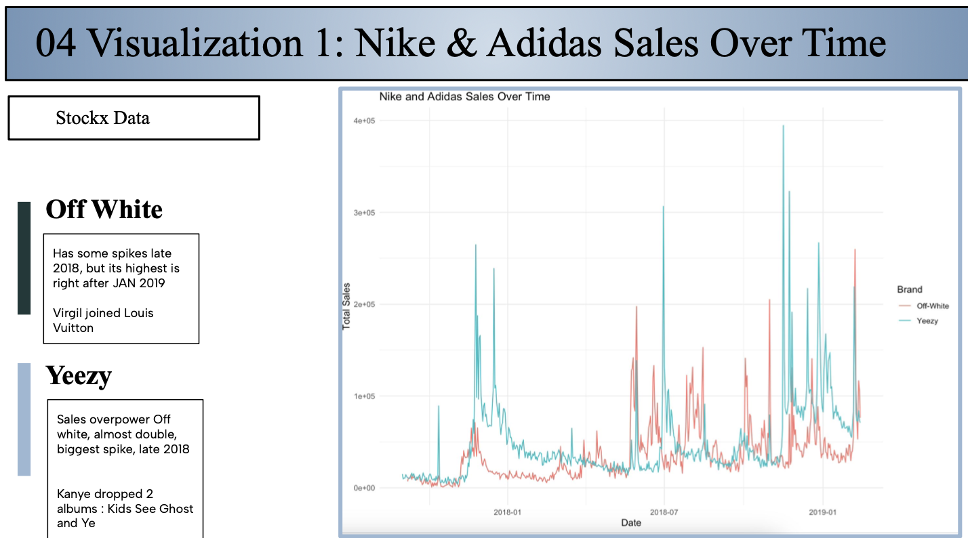
Providing Context
Student provides additional context for the findings in the chart (uses knowledge of sneaker related events)

Slide 40
Examples that need improvement

Slide 41
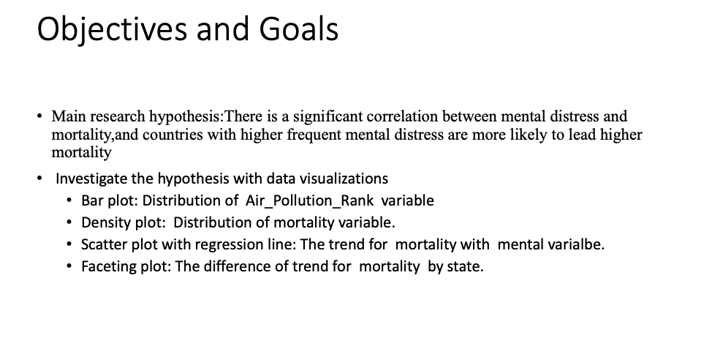
Clear objective, but it is unclear how the visualizations are tied to the objective

Slide 42
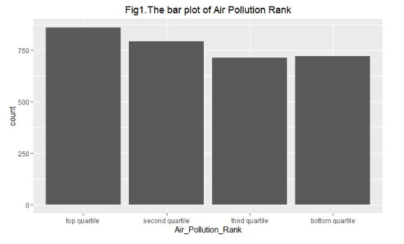
Bar Plot
Not clear how this graph helps investigate the objective (number of counties by air pollution quartile)
Only has one variable
Has title, but x axis label is not formatted
No use of color, themes
Would have been helpful to have the counts at the top of each bar

Slide 43
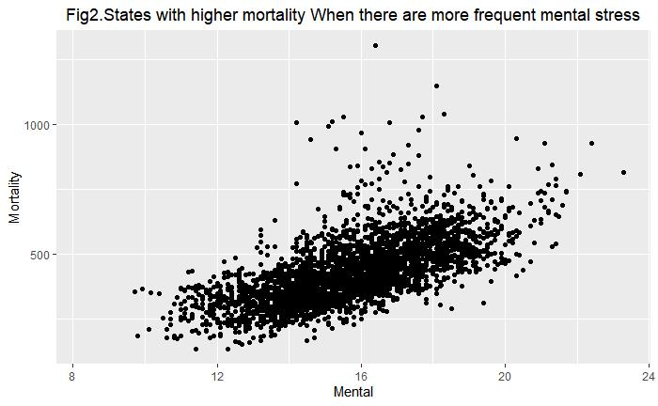
Scatter plot
Most strongly tied to objective (relationship between mental health and mortality)
Improvements:
adding a trend line
color mapping an additional variable
making size of points proportional to population size
using a theme, labels

Slide 44
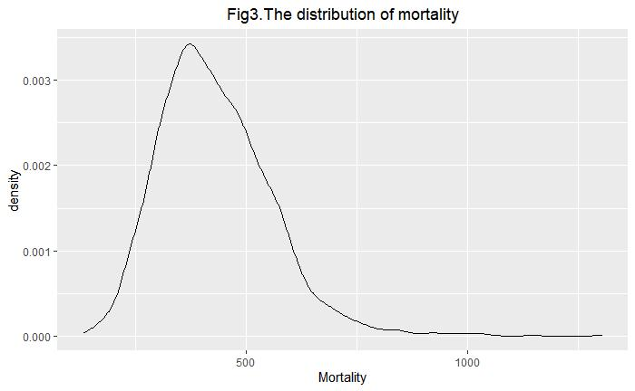
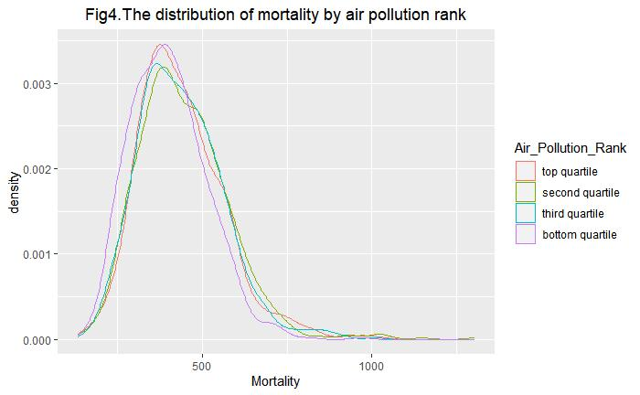
Density Plot
no clear connection to objective (mental health and mortality)
would look better with fill option
try faceting or ggridges

Slide 45
Examples that outsource to ChatGPT
(please don’t do this)

Slide 46
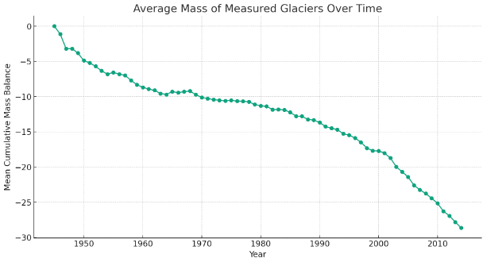
Average cumulative mass balance of reference Glaciers

Slide 47
Summarize
The plot showing the average mass of measured glaciers over time, based on the dataset you provided. The plot illustrates the trend in the mean cumulative mass balance of glaciers from 1945 onwards.
One of the most direct effects of melting glaciers is the rise in sea levels. Glaciers store a large amount of the Earth's freshwater, and when they melt, this water flows into the oceans. This contributes to the overall increase in sea levels, which can lead to the flooding of coastal areas, affecting millions of people worldwide.
Glaciers are important habitats for unique ecosystems. As they retreat, these ecosystems can be lost.

Slide 48
Rest of Class
Please work on your projects, let me know if you want feedback
Thank you for a great quarter!

